Slide 1

Project-Housing Price Prediction
Submitted by:
NEHA DIXIT

Slide 2


Slide 3
ACKNOWLEDGMENT
I would like to thanks to Flip Robo Technologies to give me a wonderful opportunity. This project is given by my SME Ms Sapna Verma. I have referred below resources that helped and guided me in completion of this project as below:-
https://www.kaggle.com/erick5/predicting-house-prices-with-machine-learning
https://studygyaan.com/data-science-ml/linear-regression-machine-learning-project-for-house-price-prediction
https://loddonhouse.co.uk/?gclid=CjwKCAjw-ZCKBhBkEiwAM4qfF_ZWhedS9VWDcP3TZ5_SVB7xuurHYsU5s4MaQzoRhiVB5fnbA1l1DxoC3G0QAvD_BwE

Slide 4
INTRODUCTION
Business Problem Framing
Houses are one of the necessary need of each and every person around the globe and therefore housing and real estate market is one of the markets which is one of the major contributors in the world’s economy. It is a very large market and there are various companies working in the domain. Data science comes as a very important tool to solve problems in the domain to help the companies increase their overall revenue, profits, improving their marketing strategies and focusing on changing trends in house sales and purchases. Predictive modelling, Market mix modelling, recommendation systems are some of the machine learning techniques used for achieving the business goals for housing companies. Our problem is related to one such housing company.
A US-based housing company named Surprise Housing has decided to enter the Australian market. The company uses data analytics to purchase houses at a price below their actual values and flip them at a higher price. For the same purpose, the company has collected a data set from the sale of houses in Australia. The data is provided in the CSV file below.

Slide 5
INTRODUCTION
Business Problem Framing
The company is looking at prospective properties to buy houses to enter the market. You are required to build a model using Machine Learning in order to predict the actual value of the prospective properties and decide whether to invest in them or not. For this company wants to know:
• Which variables are important to predict the price of variable?
• How do these variables describe the price of the house?

Slide 6
Conceptual Background of the Domain Problem
Predicting sale prices for houses, even stranger ones. Use a test-driven approach to build a Linear Regression model using Python from scratch. We will use our trained model to predict house sale prices and extend it to a multivariate Linear Regression.

Slide 7
Review of Literature
We are required to model the price of houses with the available independent variables.
Technical Requirements:
• Data contains 1460 entries each having 81 variables.
• Data contains Null values. We need to treat them using the domain knowledge and your own understanding.
• Extensive EDA has to be performed to gain relationships of important variable and price.
• Data contains numerical as well as categorical variable. We need to handle them accordingly.
• We have to build Machine Learning models, apply regularization and determine the optimal values of Hyper Parameters.
• We need to find important features which affect the price positively or negatively.
• Two datasets are being provided to us (test.csv, train.csv). We will train on train.csv dataset and predict on test.csv file.
The “Data file.csv” and “Data description.txt” are enclosed with this file.

Slide 8
Motivation for the Problem Undertaken
House is one of the important elements in basic human needs. People need a house to stay away from danger, hot weather, rainy day and as well as a place to stay calm. As long as people can fill the comfort of living under a roof then it is called a house. However, the things that matter is that the affordability of a person to purchase a house. Some people can afford a house that is really comfortable to stay in and some not. People who are called the rich and famous can afford a house that is almost called a heaven and some can only lives in an ordinary but comfortable house. But it doesnââ‚¬â„¢t matter how our house may look like because the price of house is what that matter. We can see that the housing price is increasing as the time goes by. This may be an important area to look upon because more or less it could affect the economic level of a country. Therefore, a housing price can be defined as the rate of payment that one has to pay in order to purchase a house and for sure there are several factors that lead to housing price determination.
In my own point of view, I believe that the increment of a housing price is due to the price increment in the raw material. Many may have similar idea but after looking into 10 journals as references for my propose topic, I have found out several more important variables that leads to the factors of housing price determination. There are few number of knowledgeable individual turned up and able to find the contributing factors in determination of housing price. One who has studied using an empirical analysis has shown that income (demography trends) and nominal interest rates are the key explanatory factors in housing price. On the other hand, the equity returns may also have been an influential factor in the determination of housing price.

Slide 9
Analytical Problem Framing
Mathematical/ Analytical Modeling of the Problem
This problem is a Linear Regression problem. The dataset is in CSV format and It contains 1460 training data points and 81 features that might help us predict the selling price of a house.
Build a model of housing prices to predict median house values in California using the provided dataset.
Train the model to learn from the data to predict the median housing price in any district, given all the other metrics.
Predict housing prices based on median_income and plot the regression chart for it.

Slide 10
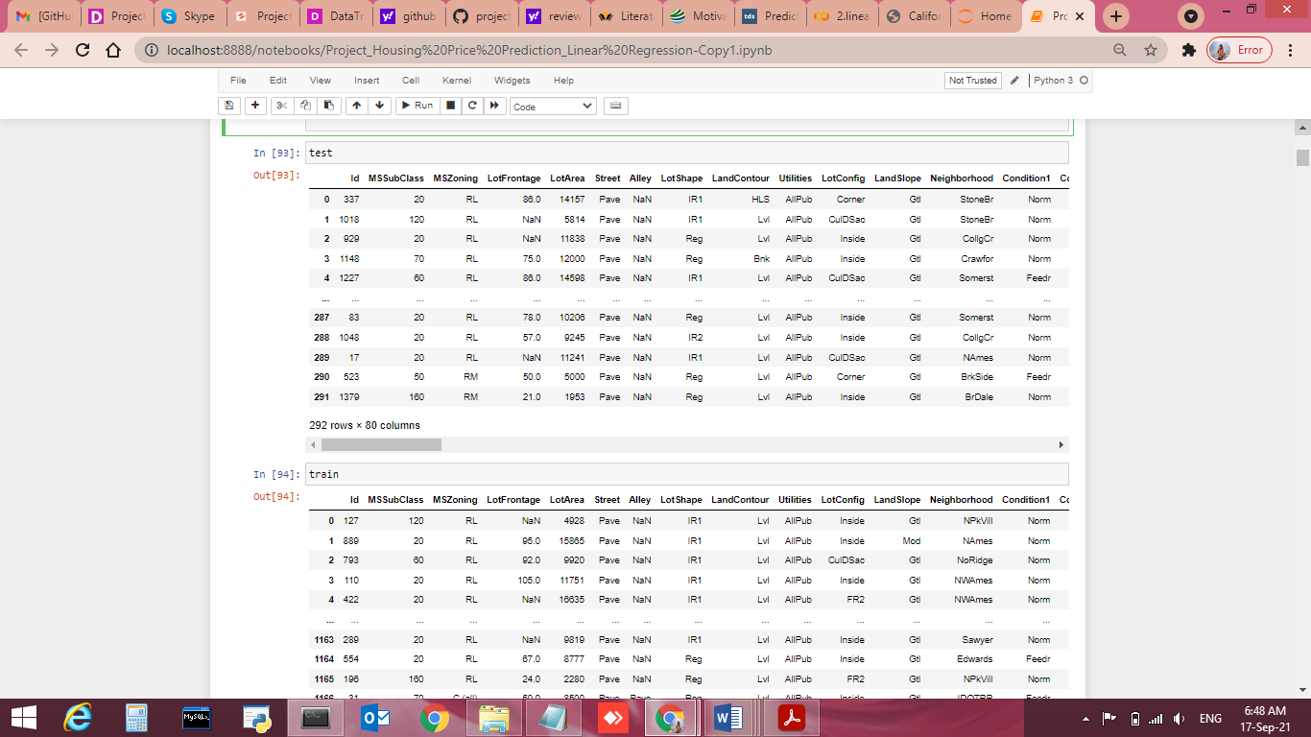
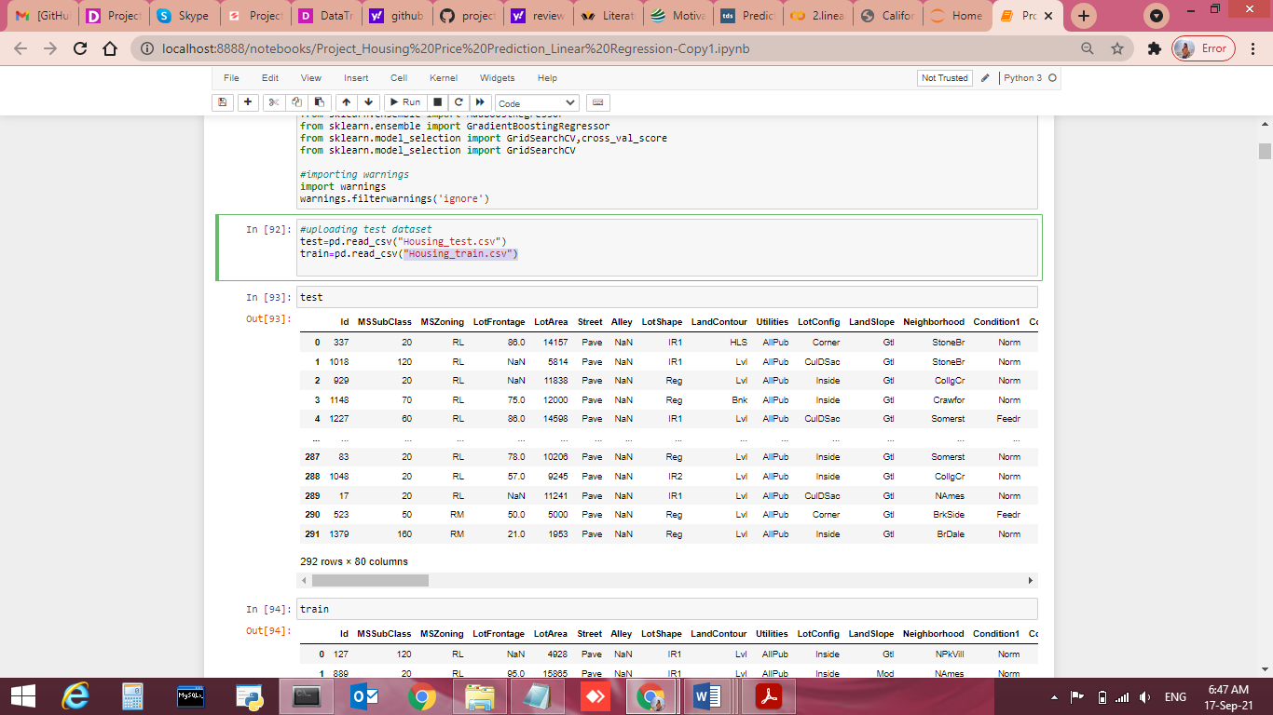
Load Data- Data Sources and their formats
This Dataset is provided by Flip Robo Technologies CSV format. In this dataset, there are 1460 rows and 81 columns.

Slide 11
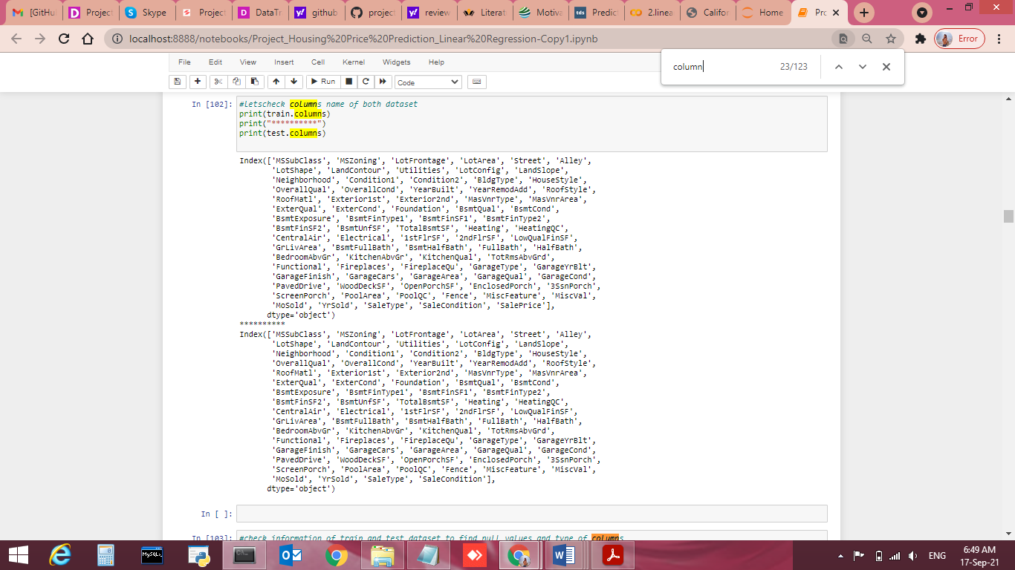
Check Columns of both Dataset
#letscheck columns name of both dataset
print(train.columns)
print("**********")
print(test.columns)

Slide 12
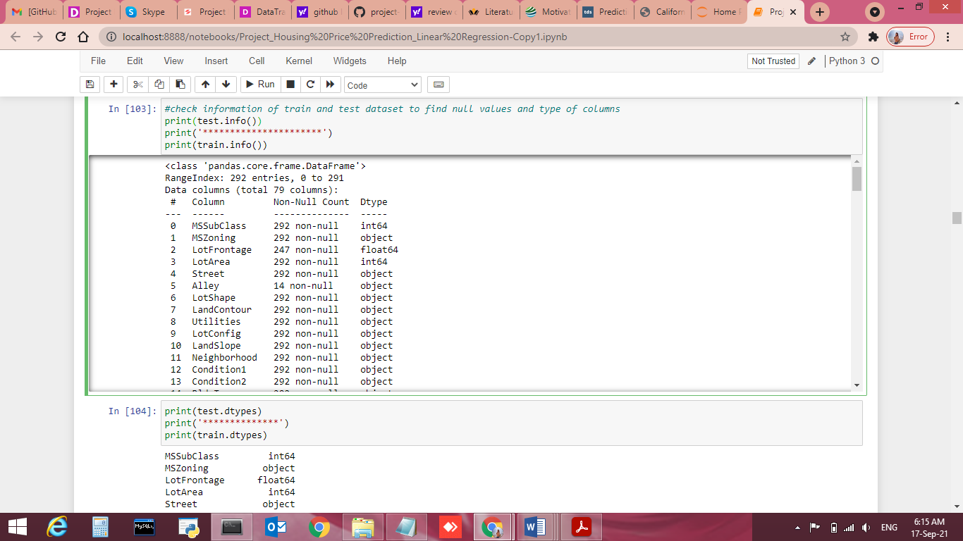
Check information's of Datasets
#check information of train and test dataset to find null values and type of columns
print(test.info())
print('**********************')
print(train.info())

Slide 13
<class 'pandas.core.frame.DataFrame'>
RangeIndex: 292 entries, 0 to 291
Data columns (total 79 columns):
# Column Non-Null Count Dtype
--- ------ -------------- -----
0 MSSubClass 292 non-null int64
1 MSZoning 292 non-null object
2 LotFrontage 247 non-null float64
3 LotArea 292 non-null int64
4 Street 292 non-null object
5 Alley 14 non-null object
6 LotShape 292 non-null object
7 LandContour 292 non-null object
8 Utilities 292 non-null object
9 LotConfig 292 non-null object
10 LandSlope 292 non-null object
11 Neighborhood 292 non-null object
12 Condition1 292 non-null object
13 Condition2 292 non-null object
14 BldgType 292 non-null object
15 HouseStyle 292 non-null object
16 OverallQual 292 non-null int64
17 OverallCond 292 non-null int64
18 YearBuilt 292 non-null int64
19 YearRemodAdd 292 non-null int64
20 RoofStyle 292 non-null object
21 RoofMatl 292 non-null object
22 Exterior1st 292 non-null object

Slide 14
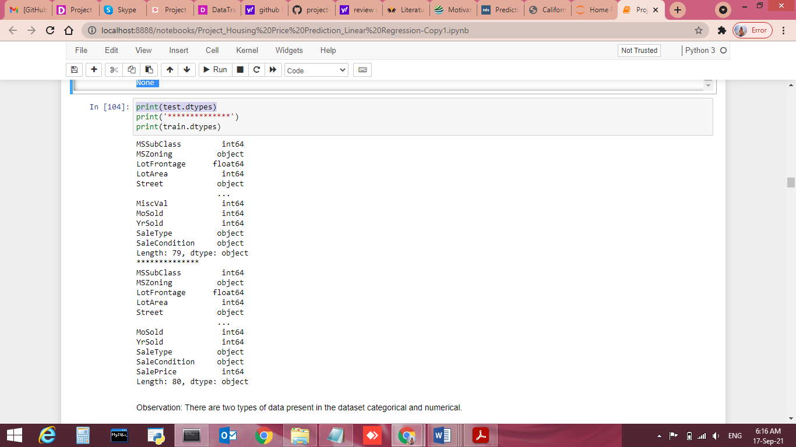
Check the Data Types
Check the Data type
print(test.dtypes)
print('**************')
print(train.dtypes)

Slide 15
Data Preprocessing Done
I checked the information, data types, null values, correlation of the independent and dependent features and from the correlation table.
Some columns can’t have any negative value, so those columns were treated accordingly.
Treated Null vales accordingly columns type.
Skewness,Outliers are treated manually for the features giving some important information, and then the threshold values were set to make the data free from outliers.
Applied StandardScaler.
Applied various machine learning model and compared it.

Slide 16
Handling Missing Values
# Let's check the missing values of top 30 columns
print(train.isnull().values.any())
print("********************")
print(train.isnull().sum().sort_values(ascending = False).head(30))
print("******************************************")
print(test.isnull().sum().sort_values(ascending = False).head(30))
Observation:
In train dataset There are 18 columns that have missing values. Major missing values columns are PoolQC, 1124-in MiscFeature, 11091-in Alley, 931-in Fence, 551-in FireplaceQu
There are 1161-missing values in the column PoolQC, 1124-in MiscFeature, 11091-in Alley, 931-in Fence, 551-in FireplaceQu,214- in LotFrontage, 64-each in GarageType, GarageCond, GarageYrBlt, GarageFinish, GarageQual, 31-in BsmtExposure and BsmtFinType2, 30-in BsmtCond and BsmtQual, 7-in MasVnrArea and MasVnrType present in our dataset.
IN test Dataset There are 19 columns that have missing values. Major missing values columns are PoolQC 292 MiscFeature 282 Alley 278 Fence 248 FireplaceQu 139

Slide 17
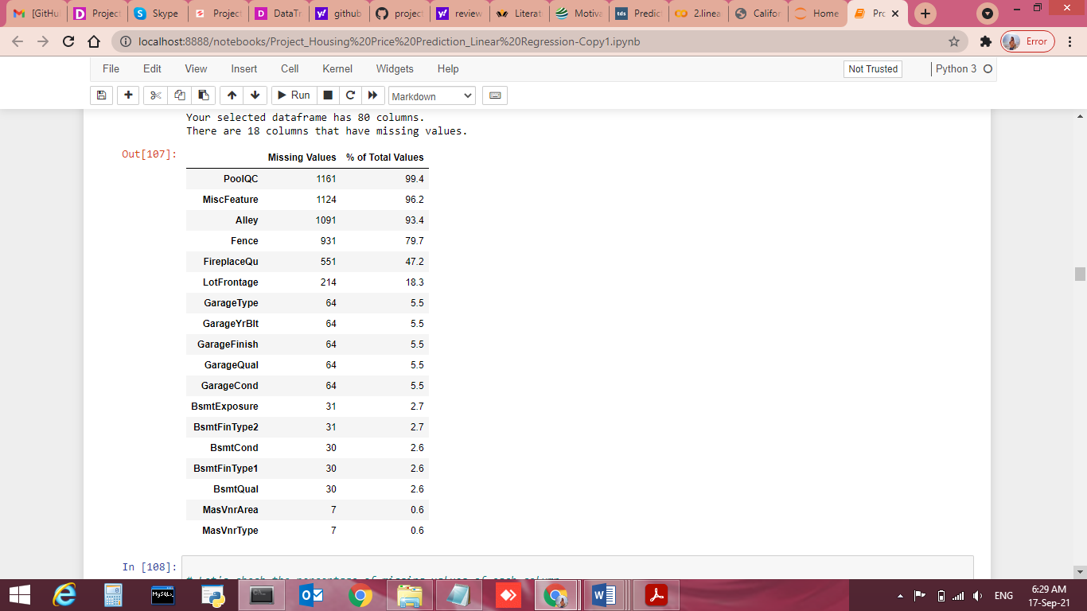
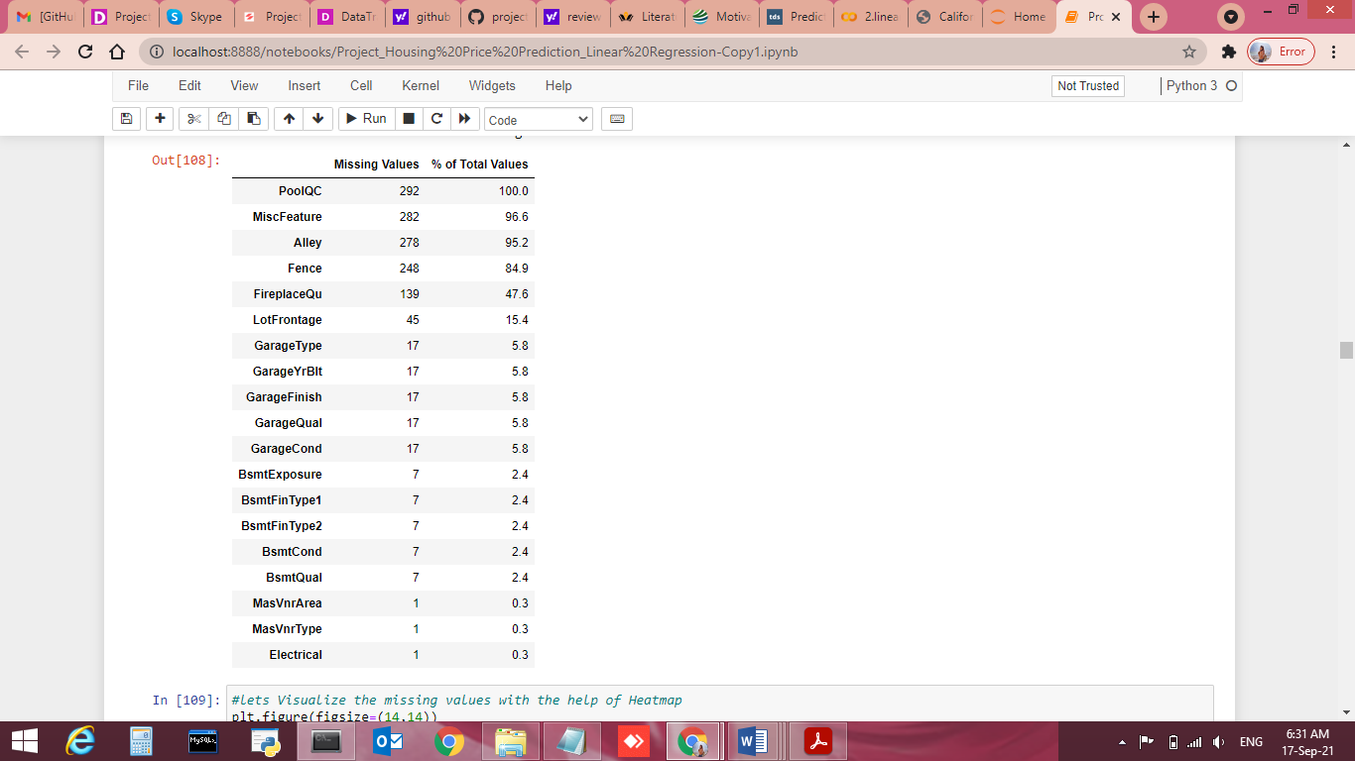
Check Percentage of Missing Values
Total Missing Value Percentage for Train dataset
Total Missing Value Percentage for Test dataset

Slide 18
Explore the categorical columns
# Let's explore the categorical columns
for column in train.columns:
if train[column].dtypes == object:
print(str(column) + ' : ' + str(train[column].unique()))
print(train[column].value_counts())
print('\n')
Observation:
1.There is only one unique value present in utilities column so we will be dropping this column.
In categorical columns there are missing values present in coumns Alley, MasVnrType, BsmtQual, BsmtCond, BsmtExposure, BsmtFinType1, BsmtFinType2, FireplaceQu, GarageType, GarageFinish, GarageQual, GarageCond, PoolQC, Fence, MiscFeature

Slide 19
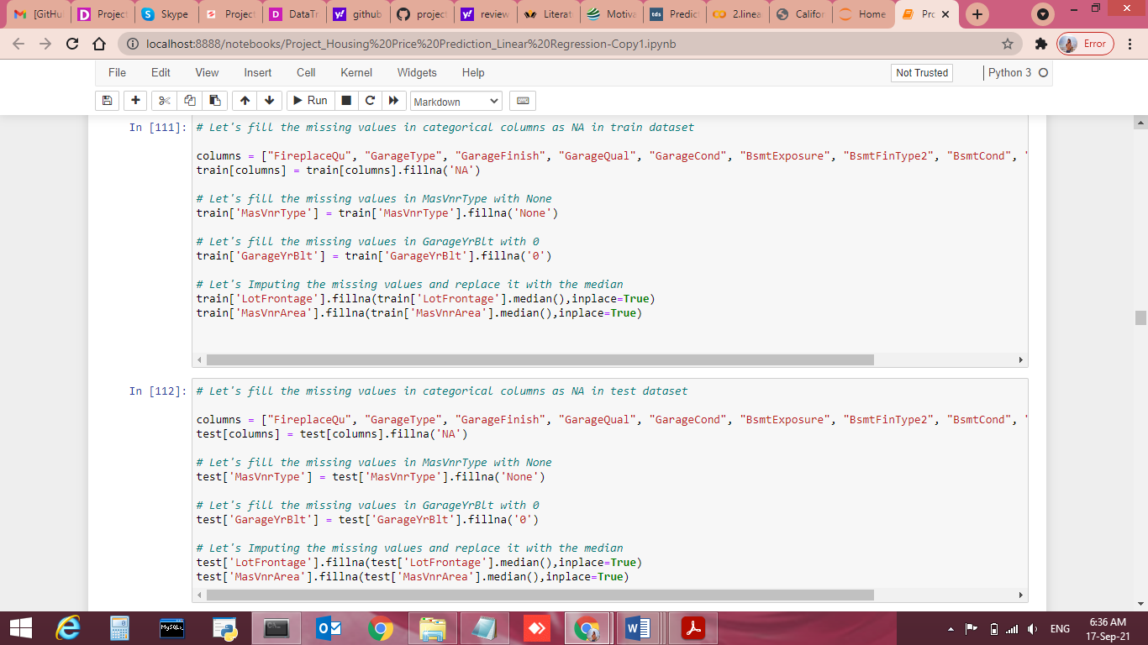
Fill Missing Values train dataset

Slide 20
Fill Missing Values test dataset

Slide 21
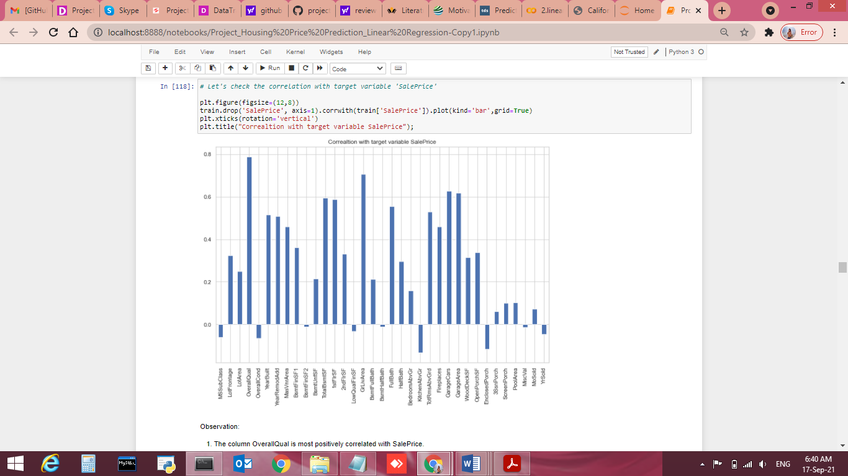
Data Inputs- Logic- Output Relationships Lets check the correlation with target variable “Salesprice”.
Observation:
The column OverallQual is most positively correlated with SalePrice.
2.The column KitchenAbvGrd and EnclosedPorch is most negatively correlated with SalePrice.

Slide 22
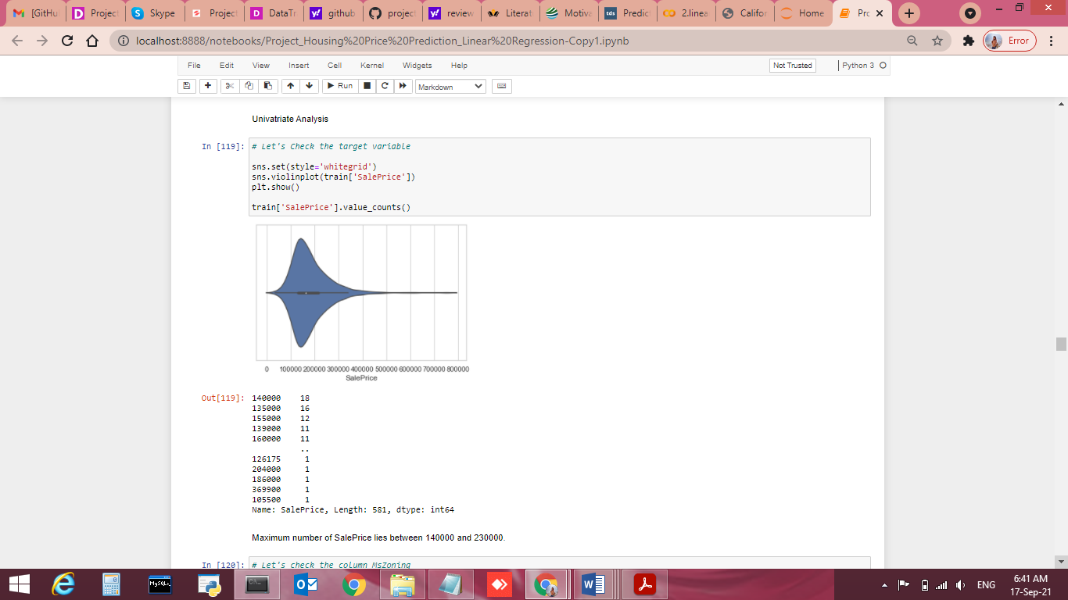
Maximum number of SalePrice lies between 140000 and 230000.

Slide 23
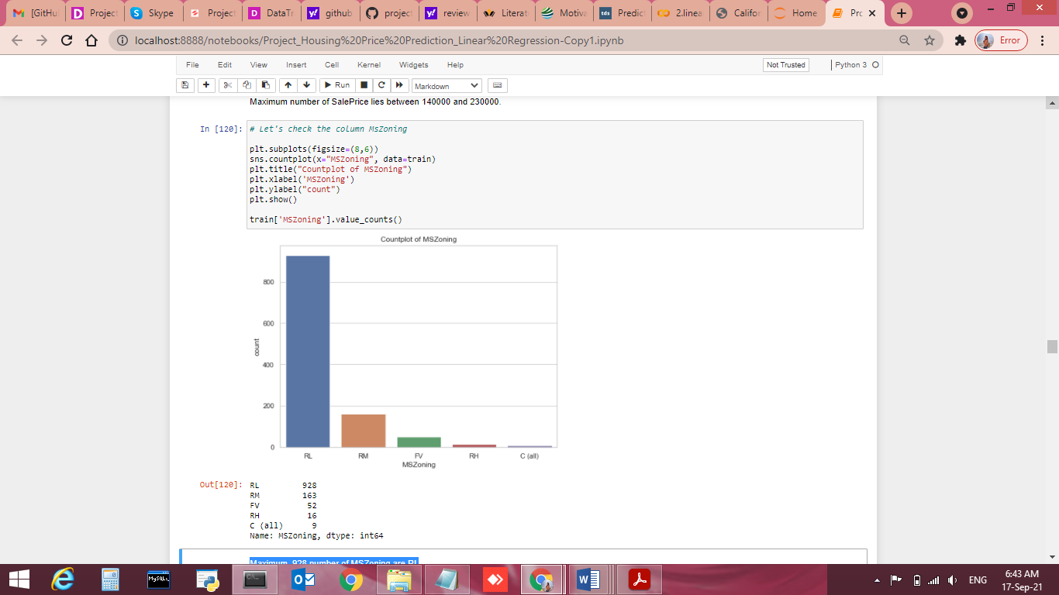
Maximum, 928 number of MSZoning are RL

Slide 24
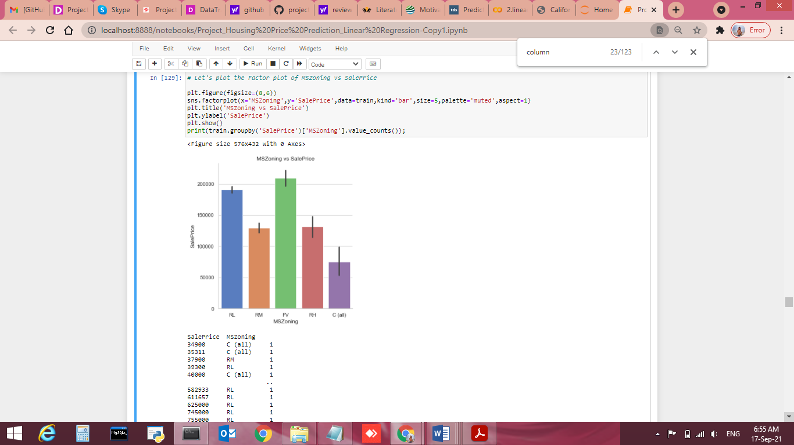
SalePrice is maximum with FV MSZOning.

Slide 25
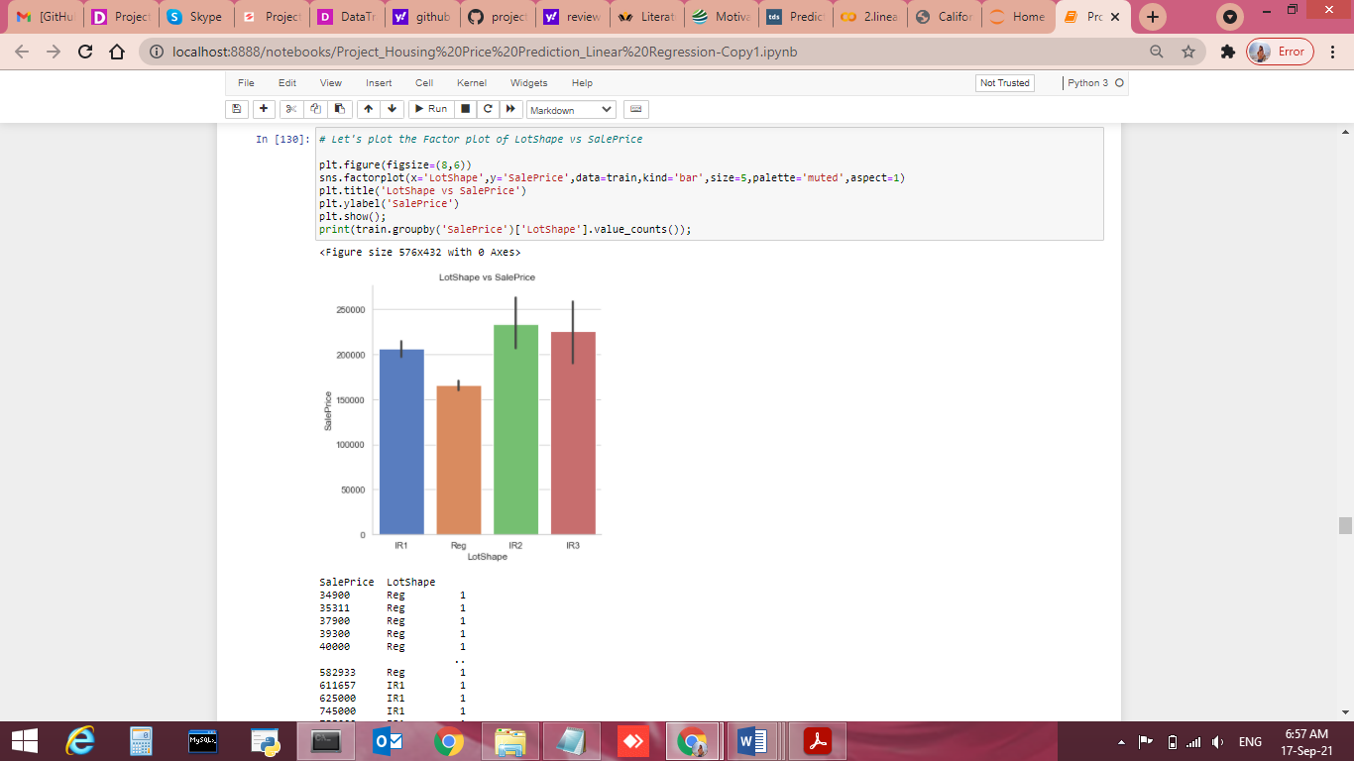
SalePrice is maximum with IR2 LotShape.

Slide 26
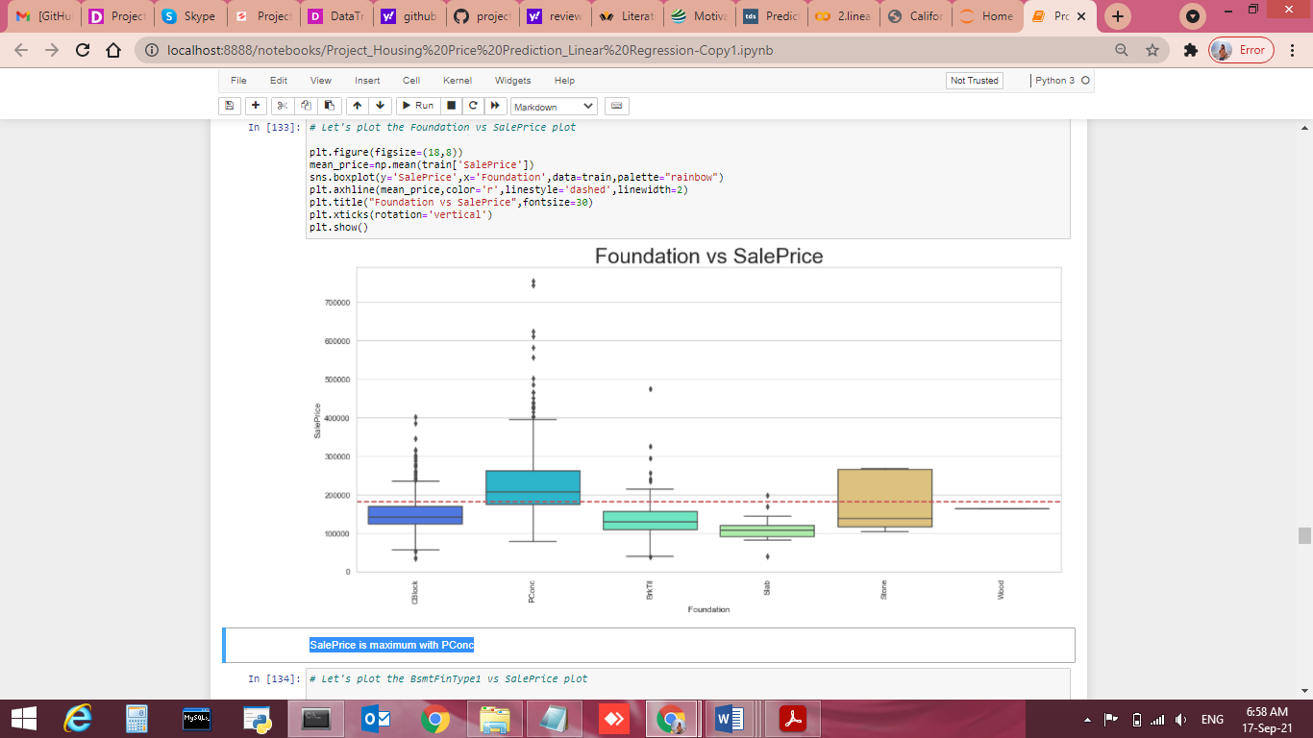
SalePrice is maximum with PConc

Slide 27
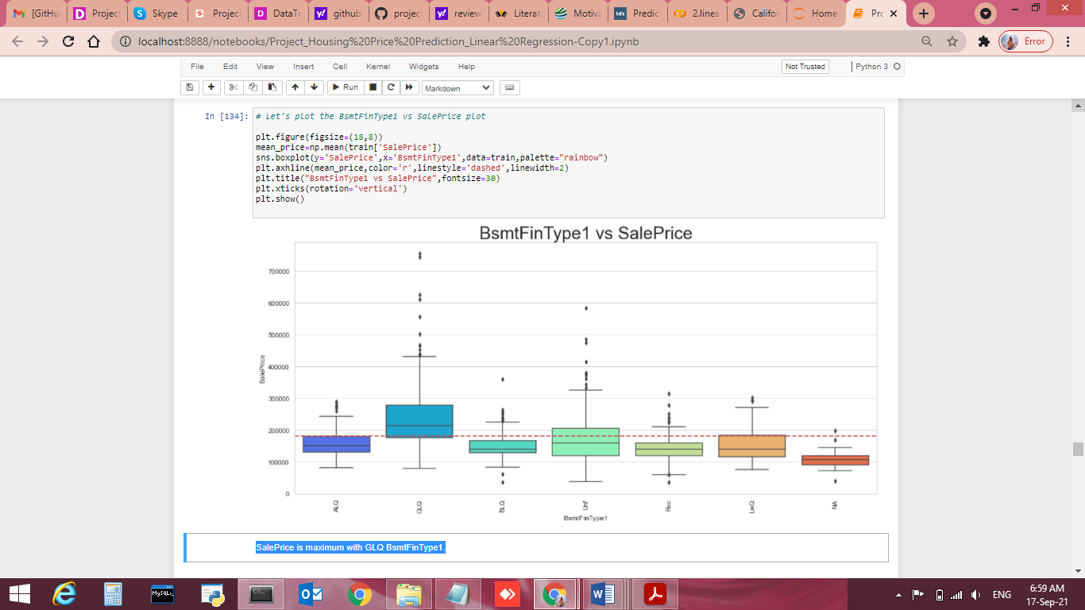
SalePrice is maximum with GLQ BsmtFinType1.

Slide 28
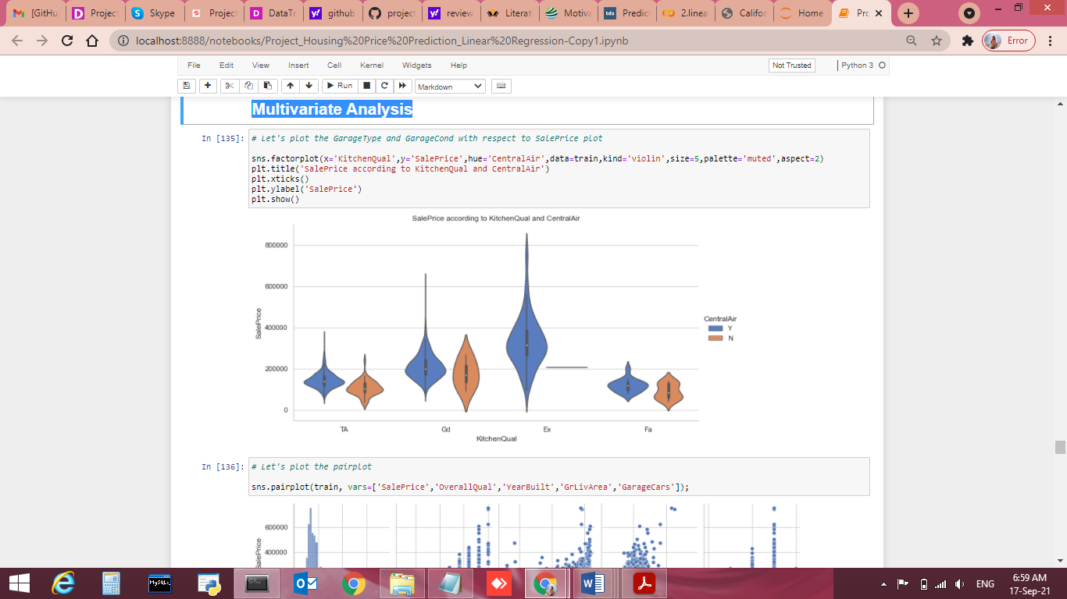
Multivariate Analysis

Slide 29
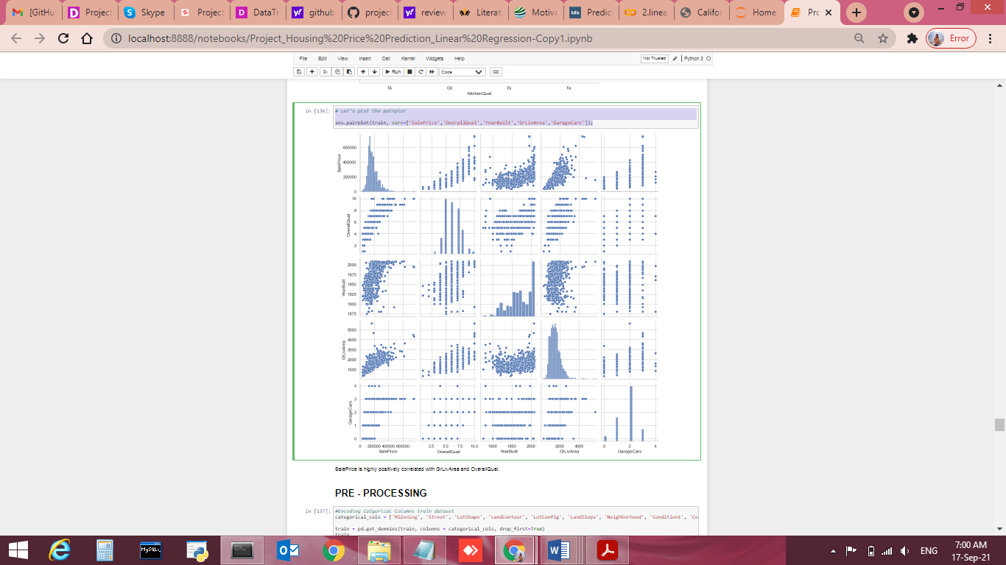
# Let's plot the pairplot sns.pairplot(train, vars=['SalePrice','OverallQual','YearBuilt','GrLivArea','GarageCars']);

Slide 30
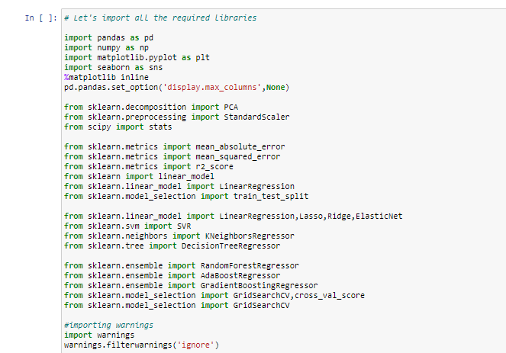
Hardware and Software Requirements and Tools Used
Windows Edition-Windows 8.1 Pro
Processor-Intel(R) Core(TM) i3-5005U CPU @ 2.00GHz 2.00GHz
Installed memory RAM- 4 GB
System Type-64 bit OS, x64 based processor
Software Requirement- Anaconda 4.9.2 , Python 3.8.5, Jupiter Notebook.
Libraries used:-

Slide 31
Model/s Development and Evaluation
Identification of possible problem-solving approaches (methods)
Analytical Approach –Based on type of data by performing EDA I have decided which model to be used for this data.
Statistical Approach – Data should be in scaled manner, it should not be distorted, for that all values using mean method due to continuous data numbers.

Slide 32
Statistical Approach for train Dataset
# Let's plot the heat map
plt.figure(figsize=(24,24))
sns.heatmap(train_cor,annot=True,fmt='.0%',cmap='Blues')
plt.show()

Slide 33
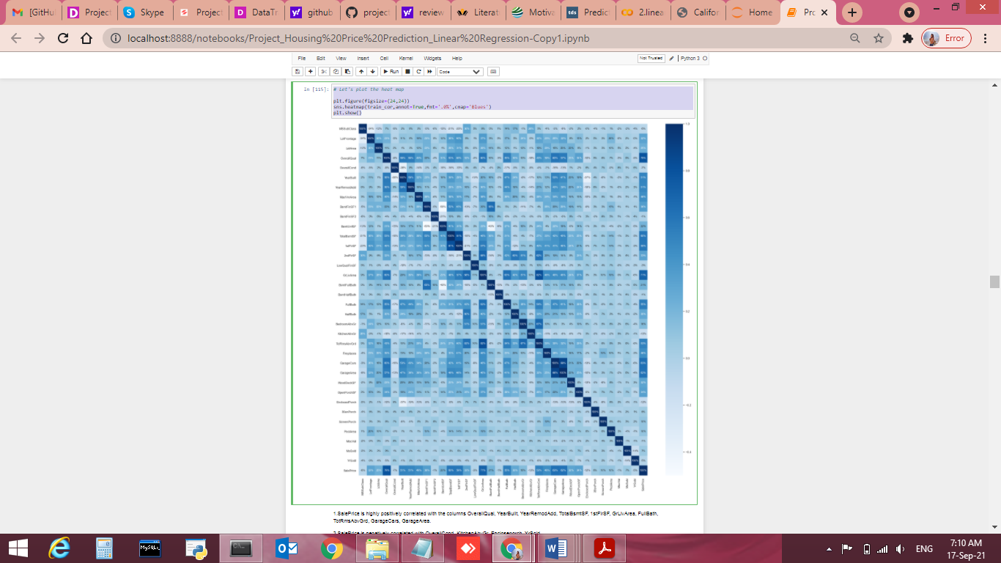
Statistical Approach for train Dataset

Slide 34
Statistical Approach for train Dataset
Observation:
TotalBsmtSF, 1stFlrSF, GrLivArea, FullBath, TotRmsAbvGrd, GarageCars, GarageArea.
2.SalePrice is negatively correlated with OverallCond, KitchenAbvGr, Encloseporch, YrSold.
3.We observe multicollinearity in between columns so we will be using Principal Component Analysis(PCA).

Slide 35
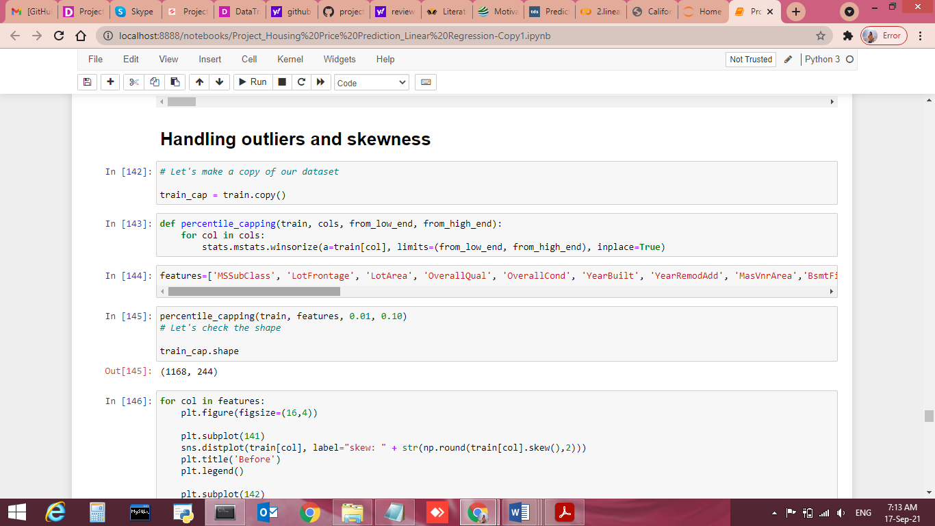
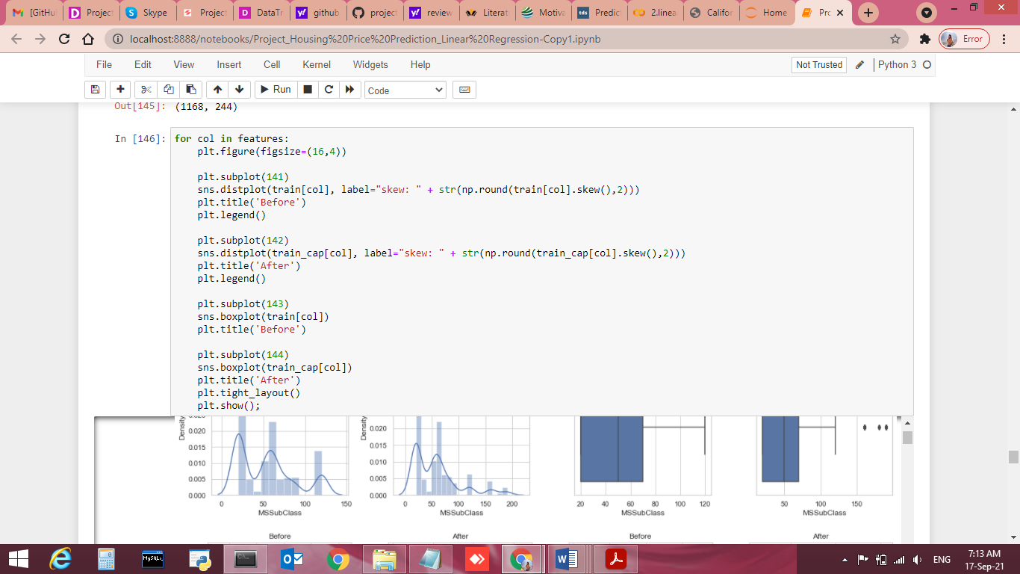
Handling Outliers and skewness

Slide 36
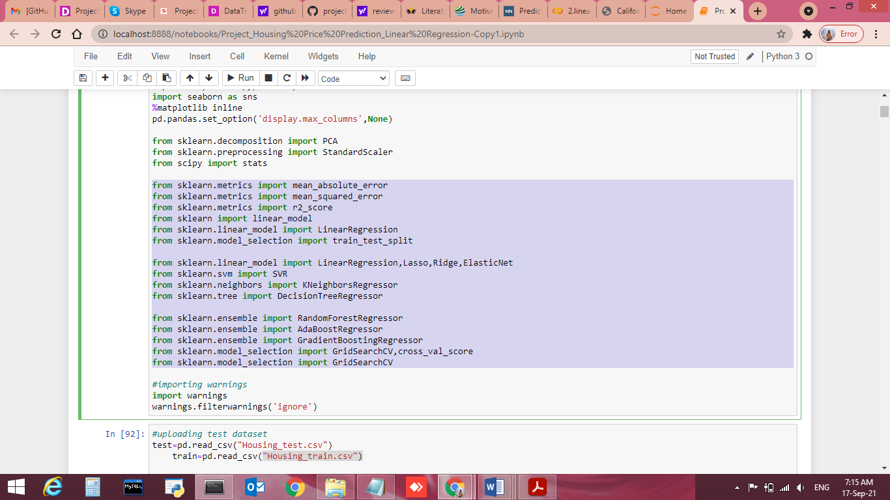
Testing of Identified Approaches (Algorithms)
All Algorithms list
from sklearn.metrics import mean_absolute_error
from sklearn.metrics import mean_squared_error
from sklearn.metrics import r2_score
from sklearn import linear_model
from sklearn.linear_model import LinearRegression
from sklearn.model_selection import train_test_split
from sklearn.linear_model import LinearRegression,Lasso,Ridge,ElasticNet
from sklearn.svm import SVR
from sklearn.neighbors import KNeighborsRegressor
from sklearn.tree import DecisionTreeRegressor
from sklearn.ensemble import RandomForestRegressor
from sklearn.ensemble import AdaBoostRegressor
from sklearn.ensemble import GradientBoostingRegressor
from sklearn.model_selection import GridSearchCV,cross_val_score
from sklearn.model_selection import GridSearchCV

Slide 37
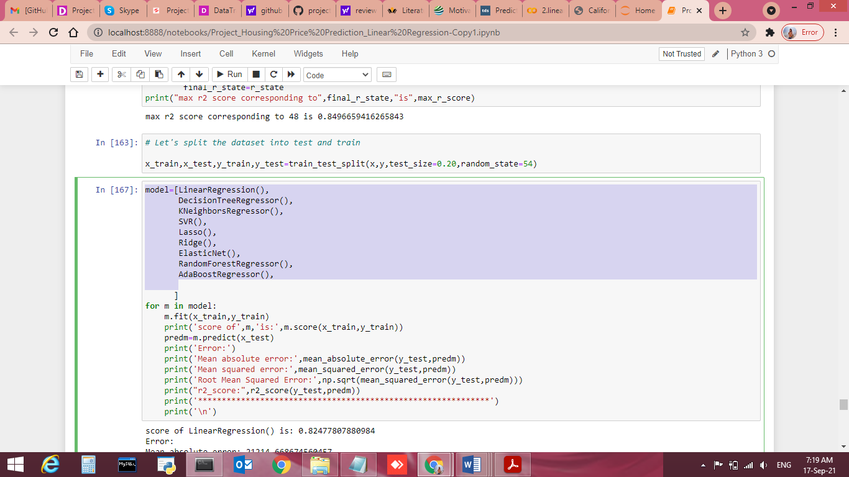
Below are Linear Regression algorithms used for the training and testing this dataset.
model=[LinearRegression(),
DecisionTreeRegressor(),
KNeighborsRegressor(),
SVR(),
Lasso(),
Ridge(),
ElasticNet(),
RandomForestRegressor(),
AdaBoostRegressor(),

Slide 38
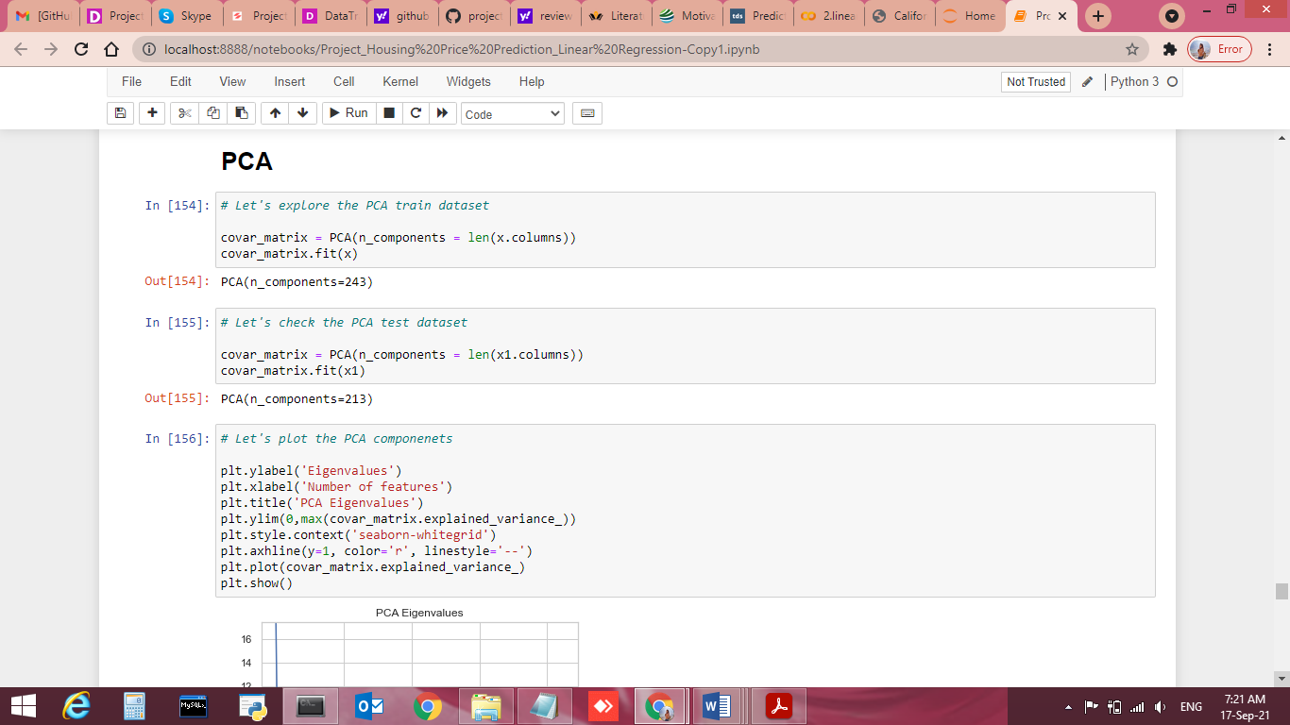
Run and Evaluate selected models PCA

Slide 39
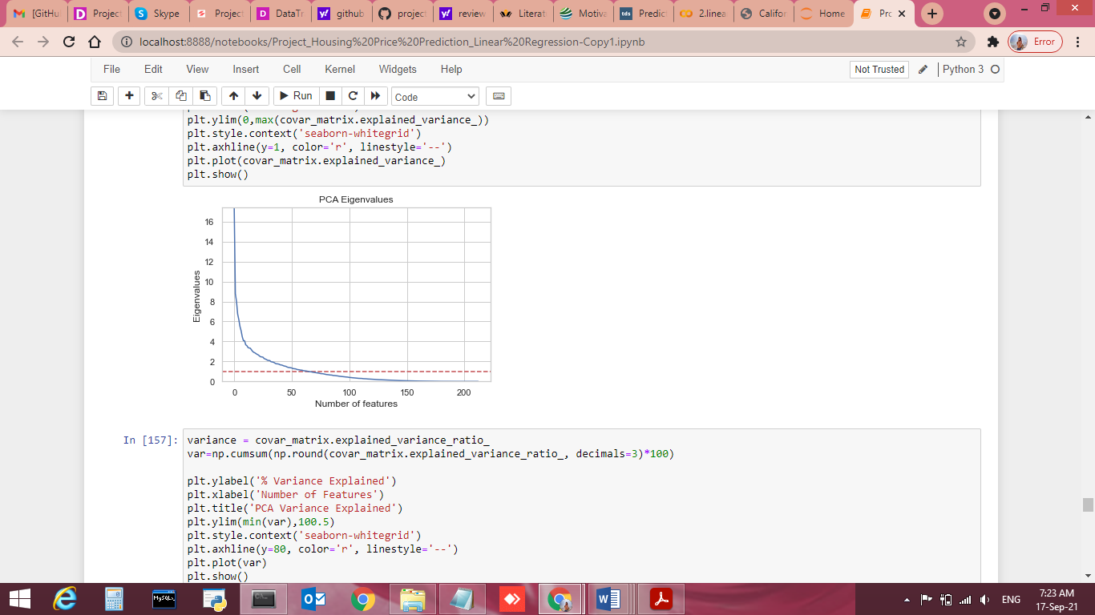
Run and Evaluate selected models PCA

Slide 40
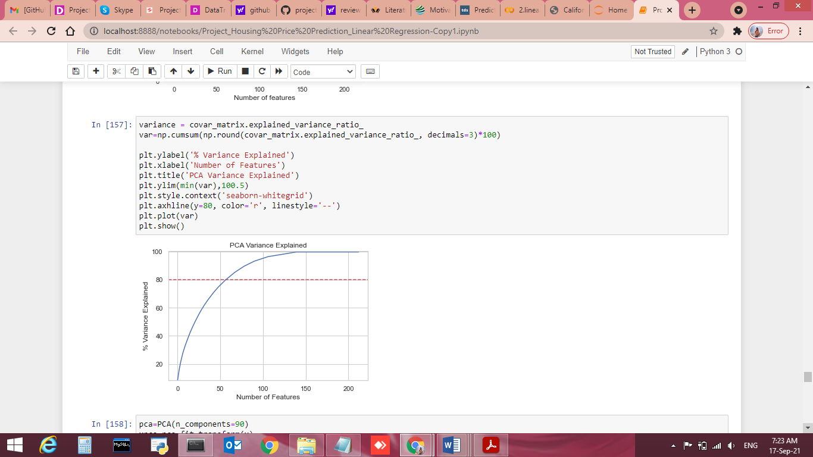
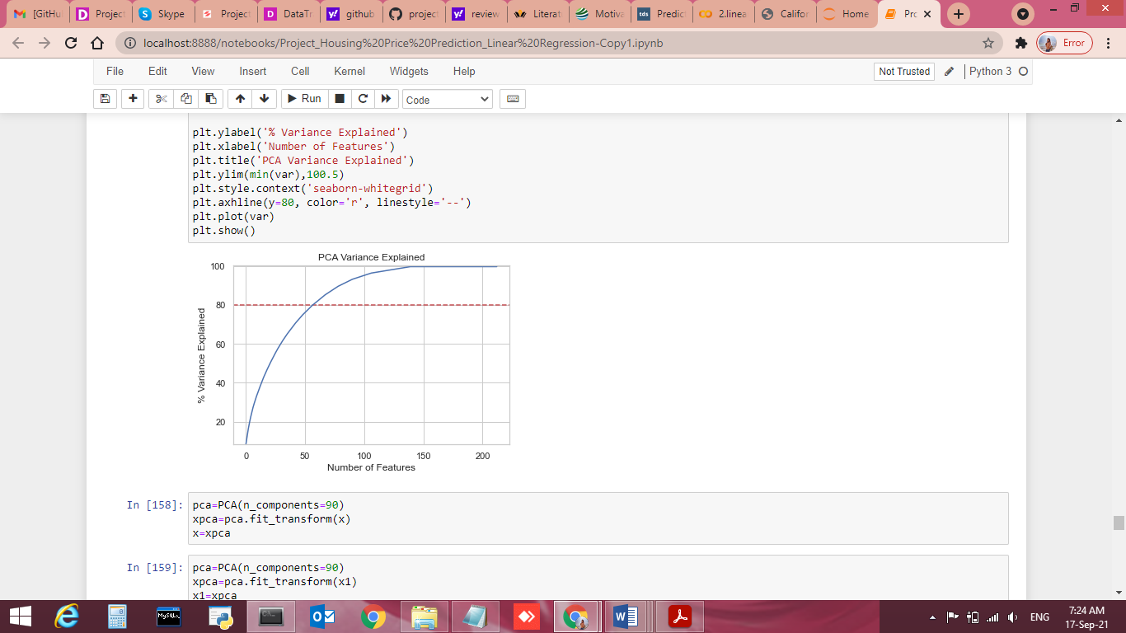
Run and Evaluate selected models PCA

Slide 41
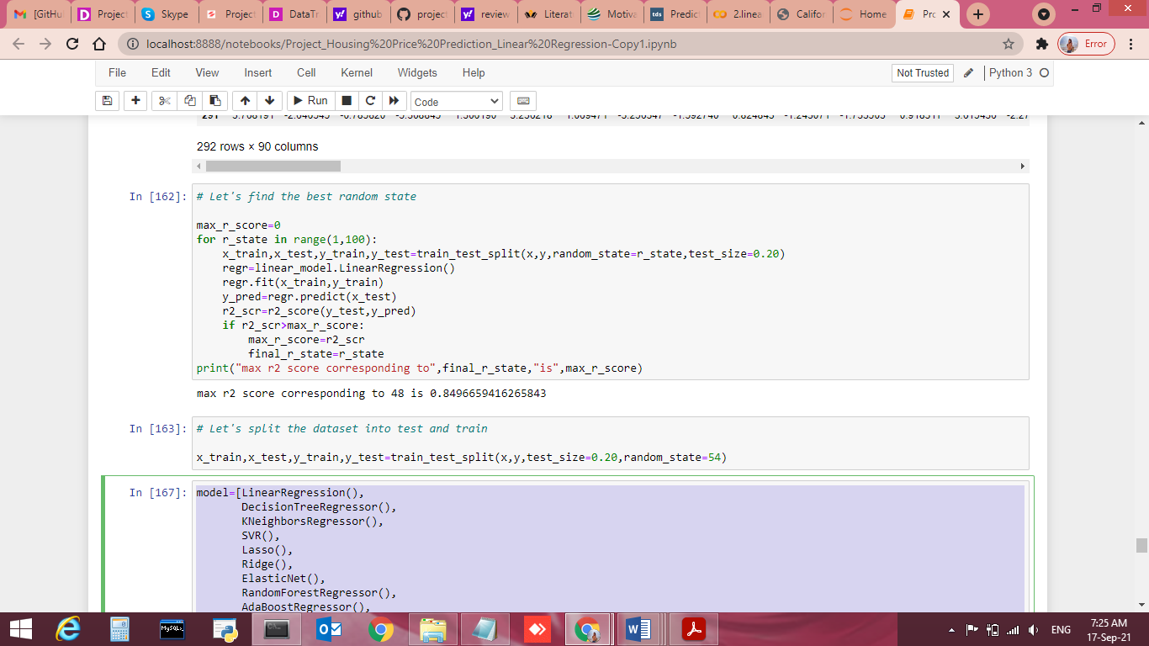
Lets find the best Random forest score
max r2 score corresponding to 48 is 0.8496659416265843

Slide 42
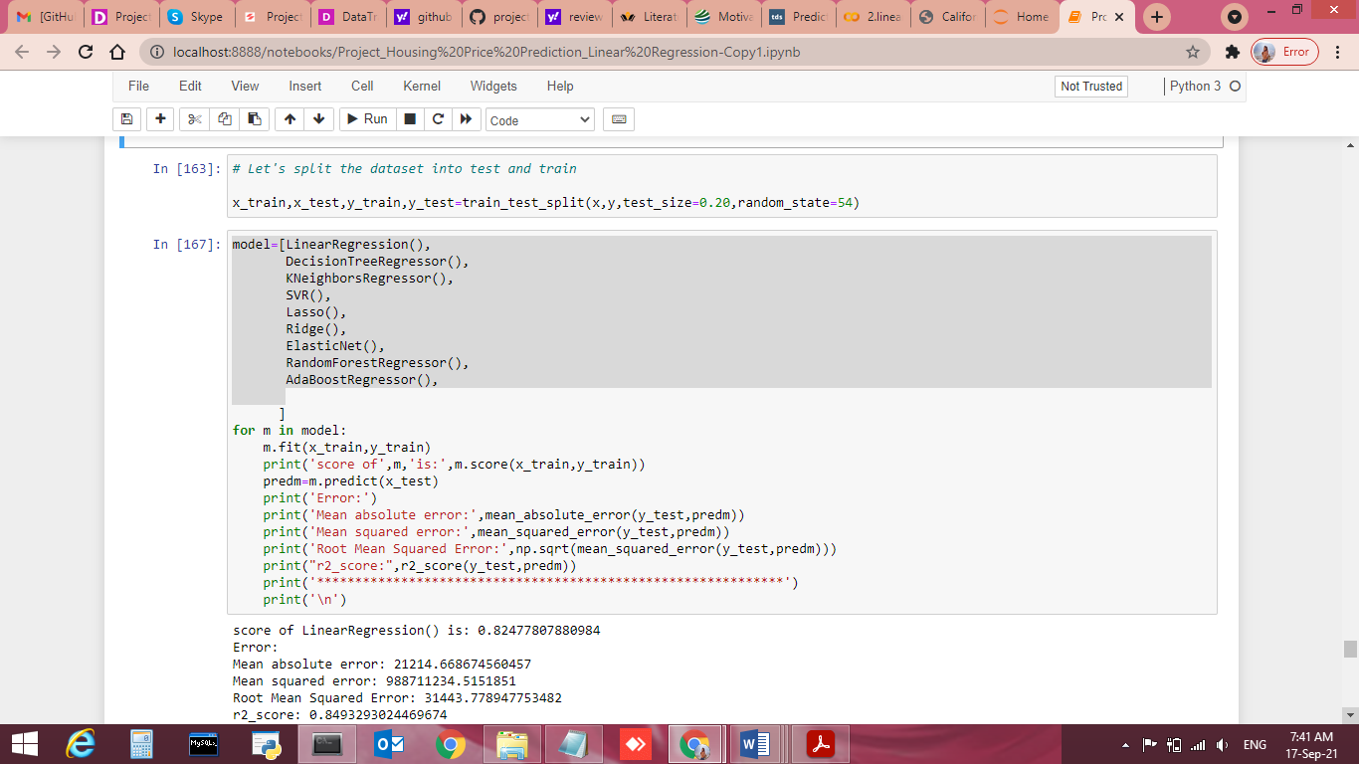
Split the dataset into test and train and Run the Model to find best RMSE

Slide 43
Linear Regression
score of LinearRegression() is: 0.82477807880984
Error:
Mean absolute error: 21214.668674560457
Mean squared error: 988711234.5151851
Root Mean Squared Error: 31443.778947753482
r2_score: 0.8493293024469674
*************************************************************

Slide 44
DecisionTree Regression
score of DecisionTreeRegressor() is: 1.0
Error:
Mean absolute error: 32526.239316239316
Mean squared error: 2655740464.3076925
Root Mean Squared Error: 51533.87686083488
r2_score: 0.5952890446589649
*************************************************************

Slide 45
Kneighbors Regressor
score of KNeighborsRegressor() is: 0.8005580881741488
Error:
Mean absolute error: 26287.979487179484
Mean squared error: 1638191388.2099144
Root Mean Squared Error: 40474.57706029693
r2_score: 0.7503543698398546
*************************************************************

Slide 46
Support Vector Regressor
score of SVR() is: -0.04568255380776742
Error:
Mean absolute error: 58256.27581850125
Mean squared error: 6883564961.965359
Root Mean Squared Error: 82967.2523467263
r2_score: -0.04899337467274023
*************************************************************

Slide 47
Lasso Regressor
score of Lasso() is: 0.8247780692387235
Error:
Mean absolute error: 21212.494199237746
Mean squared error: 988627101.9067537
Root Mean Squared Error: 31442.441093317702
r2_score: 0.8493421234996235
*************************************************************

Slide 48
Ridge Regressor
score of Ridge() is: 0.8247780154162465
Error:
Mean absolute error: 21207.71025561312
Mean squared error: 988429671.2769494
Root Mean Squared Error: 31439.301380230278
r2_score: 0.8493722101514916
*************************************************************

Slide 49
ElasticNet Regressor
score of ElasticNet() is: 0.8174701175087531
Error:
Mean absolute error: 19910.440060332676
Mean squared error: 1002174977.3116897
Root Mean Squared Error: 31657.147333764766
r2_score: 0.8472775491665279
*************************************************************

Slide 50
RandomForest Regressor
score of RandomForestRegressor() is: 0.96680098429731
Error:
Mean absolute error: 21953.085384615388
Mean squared error: 1164063400.6093924
Root Mean Squared Error: 34118.37335819796
r2_score: 0.8226072098272706
*************************************************************

Slide 51
AdaBoost Regressor
score of AdaBoostRegressor() is: 0.8380210963982864
Error:
Mean absolute error: 30931.247989936797
Mean squared error: 1749721542.0135958
Root Mean Squared Error: 41829.67298477954
r2_score: 0.7333581777413218
*************************************************************

Slide 52
Minimum RMSE Score
Ridge is giving us minimum Rmse score so we choose it as our final model.

Slide 53
Key Metrics for success in solving problem under consideration
Key Metrics used were the Lasso, ridge, Elasticnet to find r2 Score and GridsearcCV score as this was Linear Regression problem and we focus more on R2score metrics to observe Mean absolute error, Mean squared error and Root Mean Squared Error.

Slide 54
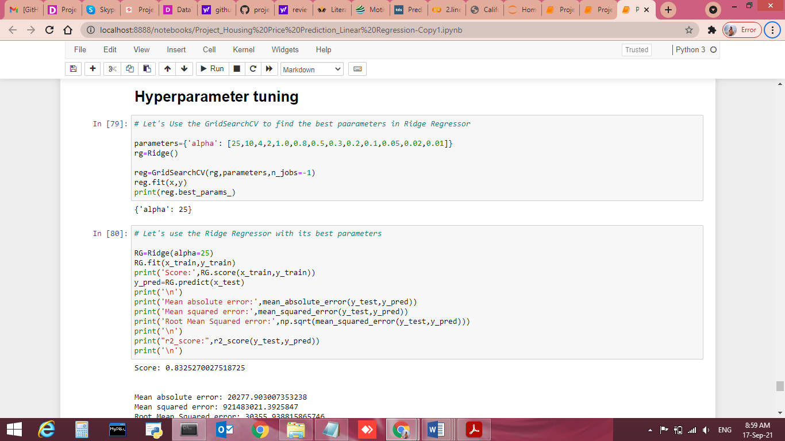
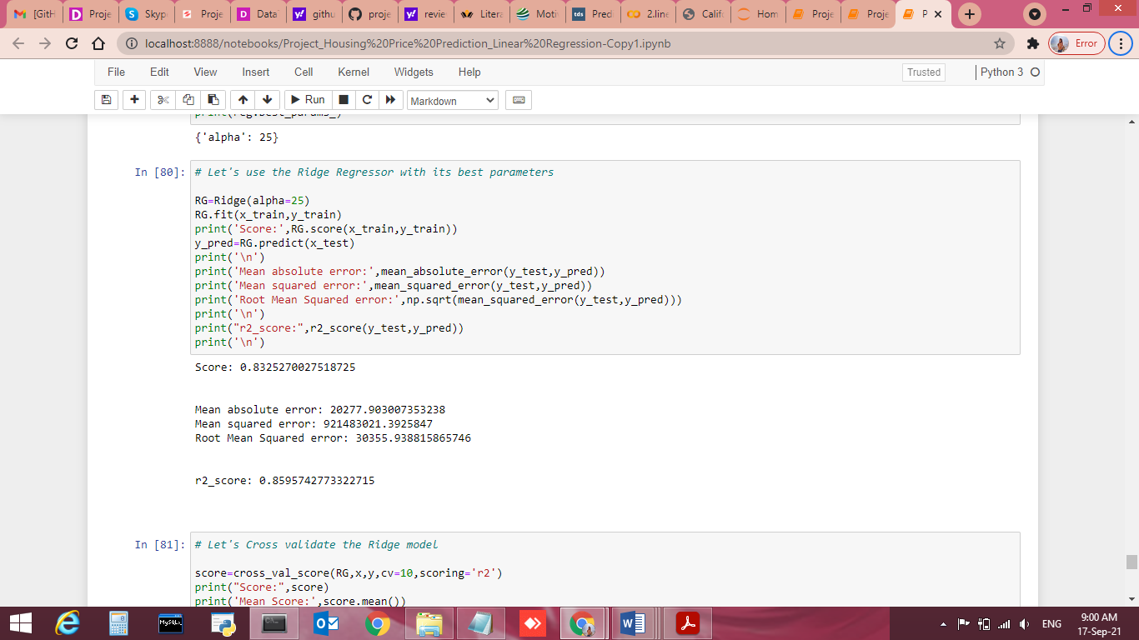
Visualizations Hyperperameter tunning
Use GridsearchCV to find Best Perameter score
Use Ridge Regressor to find Best Perameter score

Slide 55
Use Ridge Regressor to find Best Perameter score
Score: 0.8325270027518725 Mean absolute error: 20277.903007353238 Mean squared error: 921483021.3925847 Root Mean Squared error: 30355.938815865746 r2_score: 0.8595742773322715

Slide 56
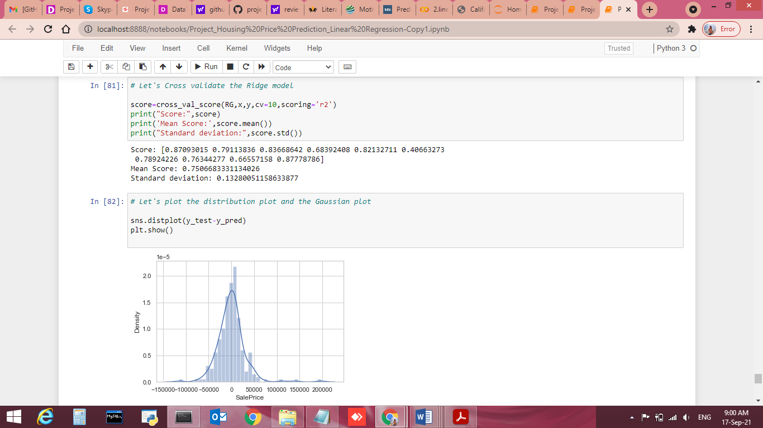
Cross Validation of Ridge Regressor

Slide 57
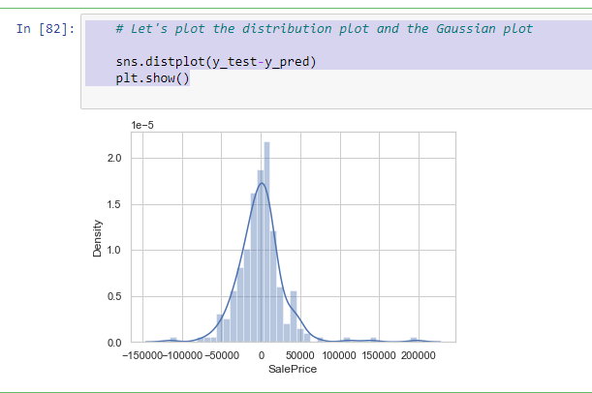
Distribution Plot of Salesprice
# Let's plot the distribution plot and the Gaussian plot
sns.distplot(y_test-y_pred)
plt.show()

Slide 58
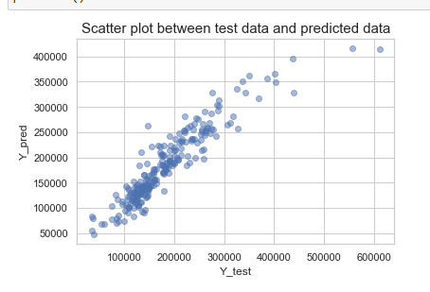
Plot the Scatter plot between test data and predicted data
# Let' plot the Scatter plot between test data and predicted data
plt.scatter(y_test,y_pred, alpha=0.5)
plt.xlabel("Y_test")
plt.ylabel("Y_pred")
plt.title("Scatter plot between test data and predicted data",fontsize=15)
plt.show()

Slide 59
Interpretation of the Results
Data Pre-processing done by performing EDA (Exploratory Data Analysis), checking for best r2 score.
We will save our Model by Ridge Regression as it is giving us minimum Rmse score as it's having 30369.236527153855 and r2_score: 0.8594512207052254.

Slide 60
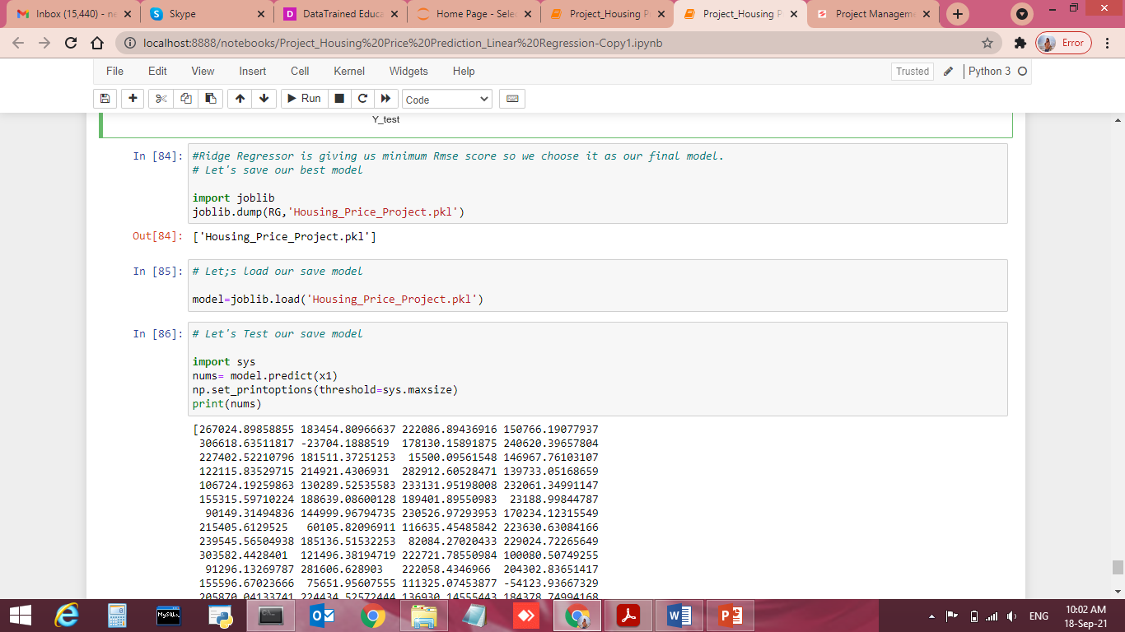
Model Saving

Slide 61
CONCLUSION
Key Findings and Conclusions of the Study
Linear regression models assume that the relationship between a dependent continuous variable Y and one or more explanatory (independent) variables X is linear (that is, a straight line). It’s used to predict values within a continuous range, (e.g. sales, price) rather than trying to classify them into categories (e.g. cat, dog).
Learning Outcomes of the Study in respect of Data Science
This dataset is Linear Regression in nature, we can verify data by using read method & get stats related information for each column using describe method.
Visualizations, Pre-processing and Data Cleaning part was very crucial as without all these all method we were not able to judge the data effectively and won’t be able to remove the outliers, handling null values and adding into the errors.
Data contains numerical as well as categorical variable. So we handled them accordingly
Check the r2 score using Mean absolute error, Mean squared error & get root mean squared error score.
Train data using Linear Regression models to get the best score & finalise best score giver model for this dataset.
Get the test score for same model.
Save file using joblib library.

Slide 62
CONCLUSION
Limitations of this work and Scope for Future Work
Visualizations helped a lot in finding out those outliers values and helped in finding out the features having direct relation between the feature and the label.
Its always good to to have complete data while performing model but 7-8 % of data can be excluded based on performance impact.

